Slide 1
Volcano Plot for Metabolomics Data
Ke Xu
10/06/2020

Slide 2
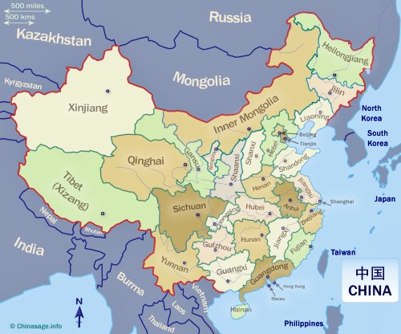

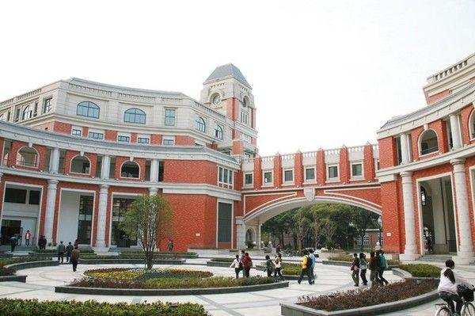
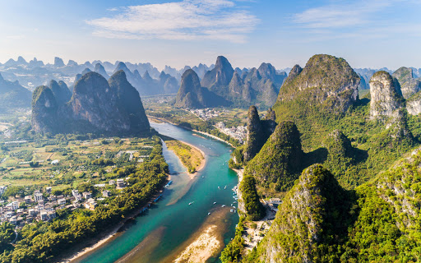
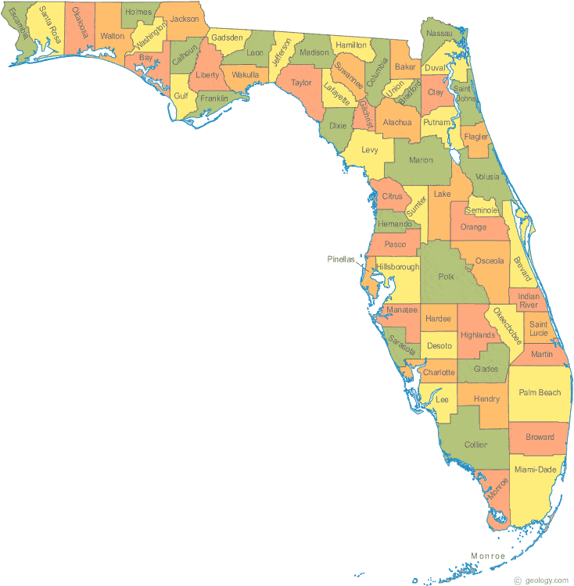


Shanghai
University of Shanghai for Science and Technology
Guilin

Slide 3
Table of Content
Metabolomics
Steps for Volcano Plot
R Codes for RUMP

Slide 4
Metabolomics
Metabolomics provides a wealth of information about the biochemical status of cells, tissues, and other biological systems.
Mass spectrometry coupled with gas chromatography (GC-MS)
Liquid chromatography (LC-MS)
Capillary electrophoresis mass spectrometry (CE-MS)
Nuclear magnetic resonance (NMR)

Slide 5
Volcano Plot
A metabolomics experiment often involves a comparison of two groups (treatment group versus a control).
Volcano plot is used to identify discriminatory features.

Slide 6
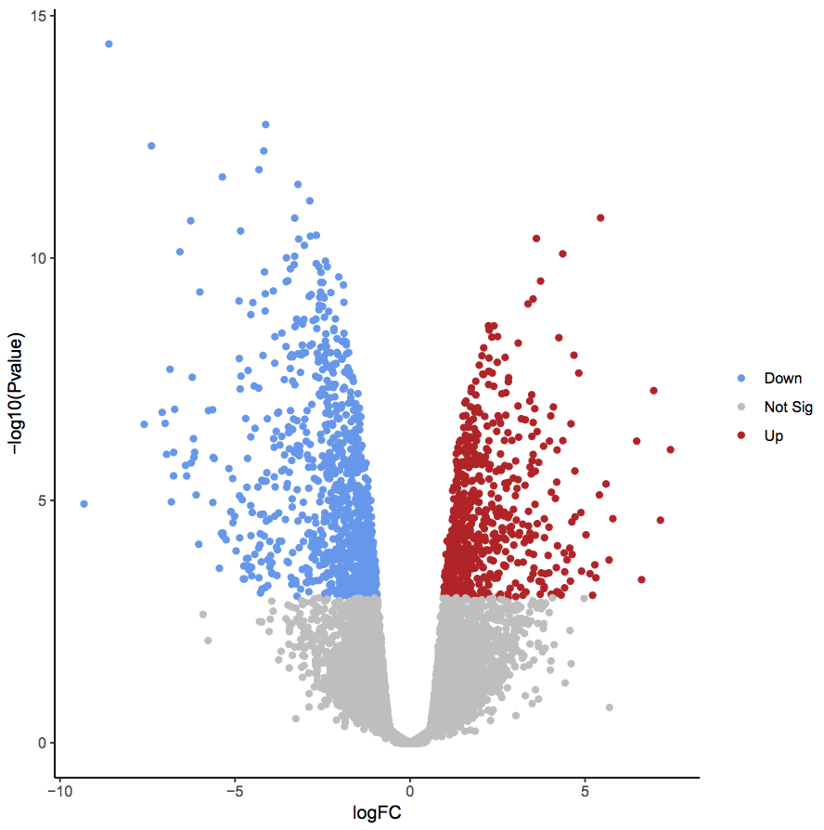
Volcano Plot
This type of plot displays the fold change differences and the statistical significance for each variable.
Data points that are far from the origin, i.e., near the top of the plot and to the far left or right, are considered important variables with potentially high biological relevance.

Slide 7
Volcano Plot
Step 1. Calculate the mean of each group (group1mean, group2mean)
Step 2. FC=group1mean/group2mean, Log₂FC=Log(FC,2)
Step 3. Use T.test to calculate the p.value and use a multiple testing correction (Bonferroni correction) for calculating adjusted p.value
Step 4. Volcano Plot

Slide 8

Why R?
R is a software environment for statistical computing, data analysis, and graphics, which has become an essential tool in all areas of bioinformatics research. A major advantage of R over commercial software is that it is open source and free to all users.

Slide 9
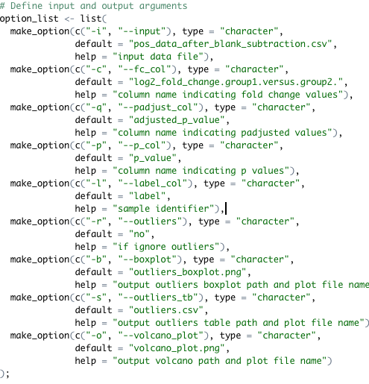
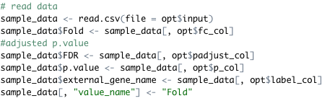
Volcano Plot
Data: pos_data_after_blank_subtraction.csv
Variables: log2_fold_change.group1.versus.group2,
p.value, adjusted_p_value, and label.
Notes:
\

Slide 10
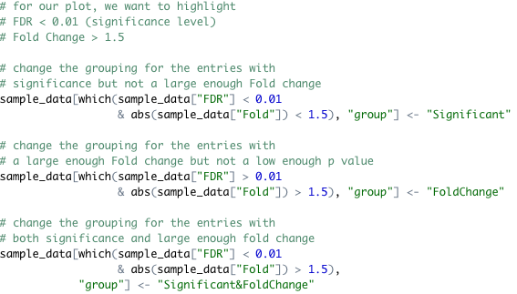
Volcano Plot
Add grouping column
Significant level = 0.01
FDR < 0.01 Significant
Fold > 1.5 FoldChange

Slide 11
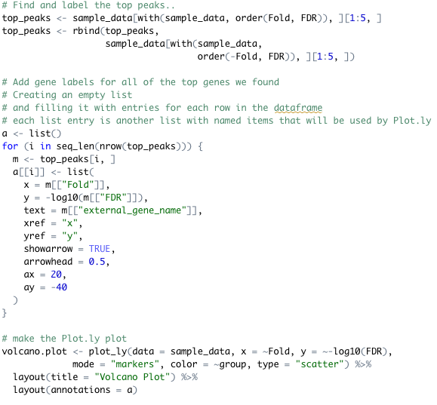
Volcano Plot
ggplot2
Volcano plot

Slide 12
Volcano Plot

Slide 13
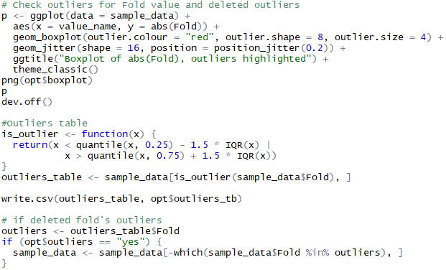
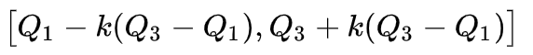
Volcano Plot
Check outliers

Slide 14
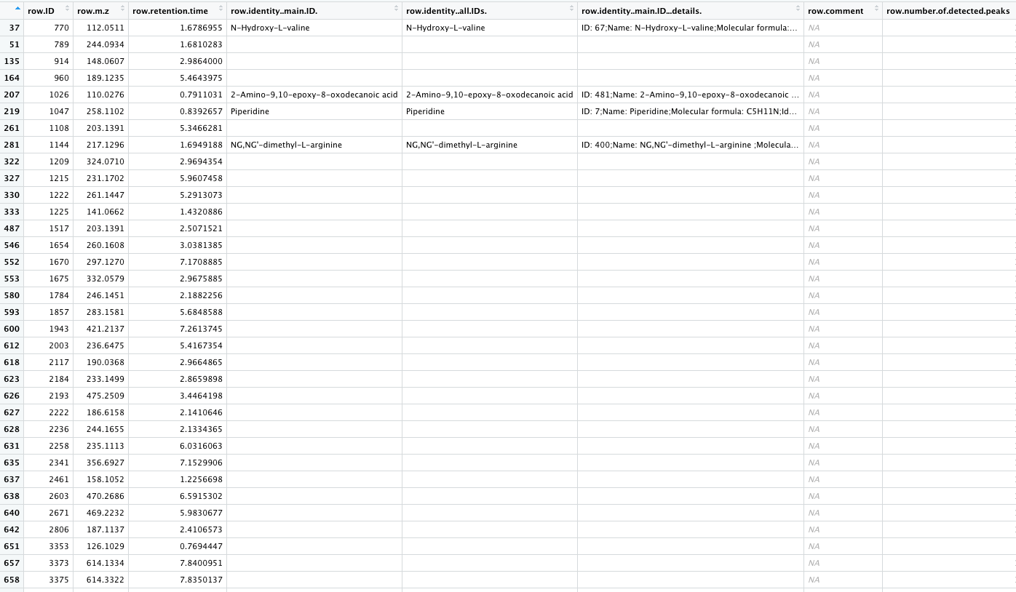
Volcano Plot
Table for outliers

Slide 15
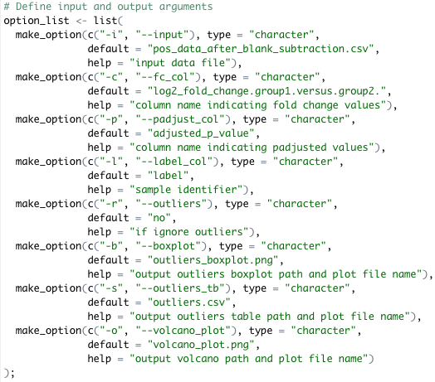
Volcano Plot
After excluded outliers

Slide 16
Thank you!

